Slide 1
15-780 – Graduate Artificial Intelligence:
Probabilistic modeling: 2
Aditi Raghunathan
Carnegie Mellon University
Spring 2023

Slide 2
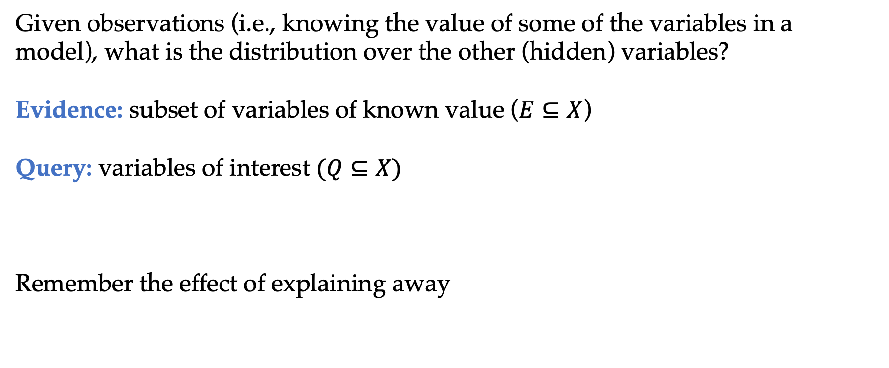
The inference problem
Given observations (i.e., knowing the value of some of the variables in a model), what is the distribution over the other (hidden) variables?
Evidence: subset of variables of known value ($E⊆X$)
Query: variables of interest $(Q⊆X)$
Remember the effect of explaining away

Slide 3
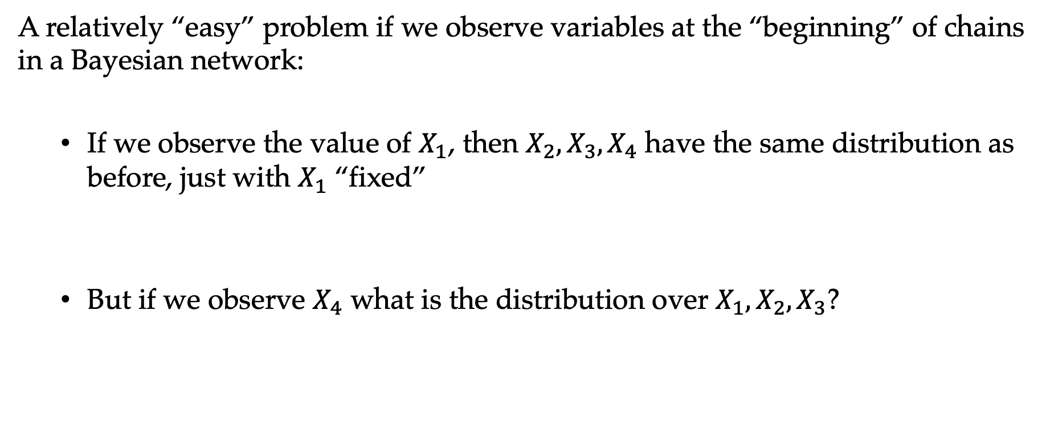
The inference problem
A relatively “easy” problem if we observe variables at the “beginning” of chains in a Bayesian network:
  If we observe the value of $X_{1}$, then $X_{2},X_{3},X_{4}$ have the same distribution as before, just with $X_{1}$ “fixed”
  But if we observe $X_{4}$ what is the distribution over $X_{1}, X_{2},X_{3}$?

Slide 4
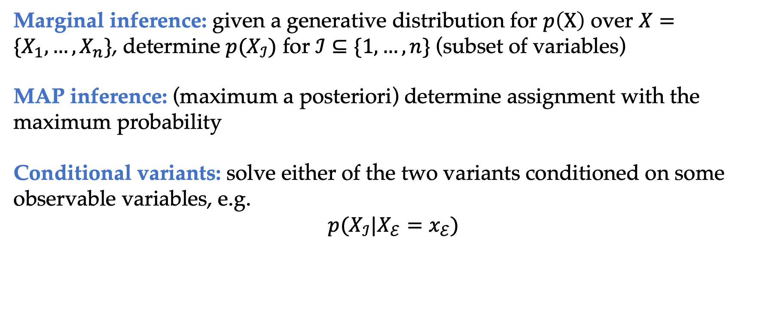
Many types of inference problems
Marginal inference: given a generative distribution for $p\left(X\right)$ over $X=\{X_{1},…,X_{n}\}$, determine $p(X_{ℐ})$ for $ℐ⊆\{1,…,n\}$ (subset of variables)
MAP inference: (maximum a posteriori) determine assignment with the maximum probability
Conditional variants: solve either of the two variants conditioned on some observable variables, e.g.
$$p(X_{ℐ}|X_{ℰ}=x_{ℰ})$$

Slide 5
Approaches to inference
There are three categories of common approaches to inference (more exist, but these are most common)
Exact methods: Bayes’ rule or variable elimination methods
Sampling approaches: draw samples from the the distribution over hidden variables, without construction them explicitly
Approximate variational approaches: approximate distributions over hidden variables using “simple” distributions, minimizing the difference between these distributions and the true distributions

Slide 6
Outline
Probabilistic graphical models
Probabilistic inference
Exact inference
Sample-based inference
Learning Bayesian networks

Slide 7
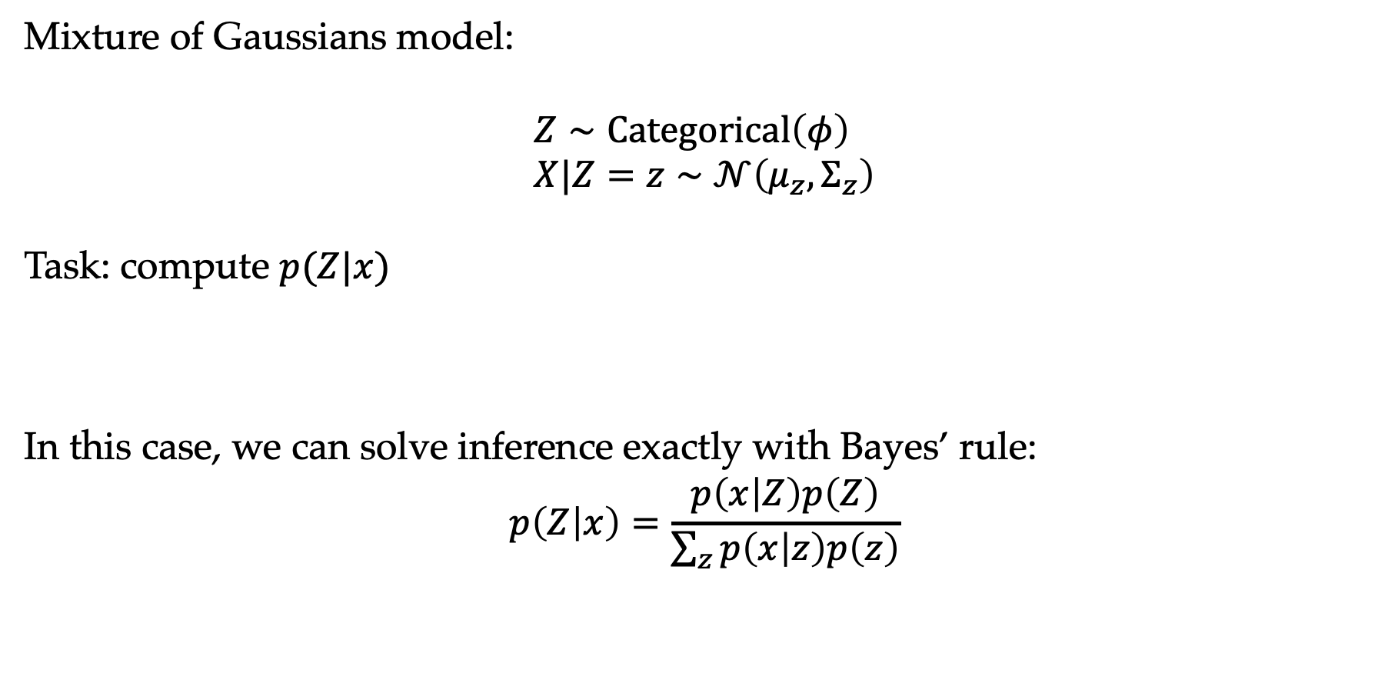
Exact inference example
Mixture of Gaussians model:
$$Z∼Categorical\left(φ\right) \\ X|Z=z∼𝒩\left(μ_{z}, Σ_{z}\right)$$
Task: compute $p(Z|x)$
In this case, we can solve inference exactly with Bayes’ rule:
$$p\left(Z | x\right)=\frac{p\left(x | Z\right)p\left(Z\right)}{\sum_{z}{p\left(x | z\right)p\left(z\right)}}$$

Slide 8
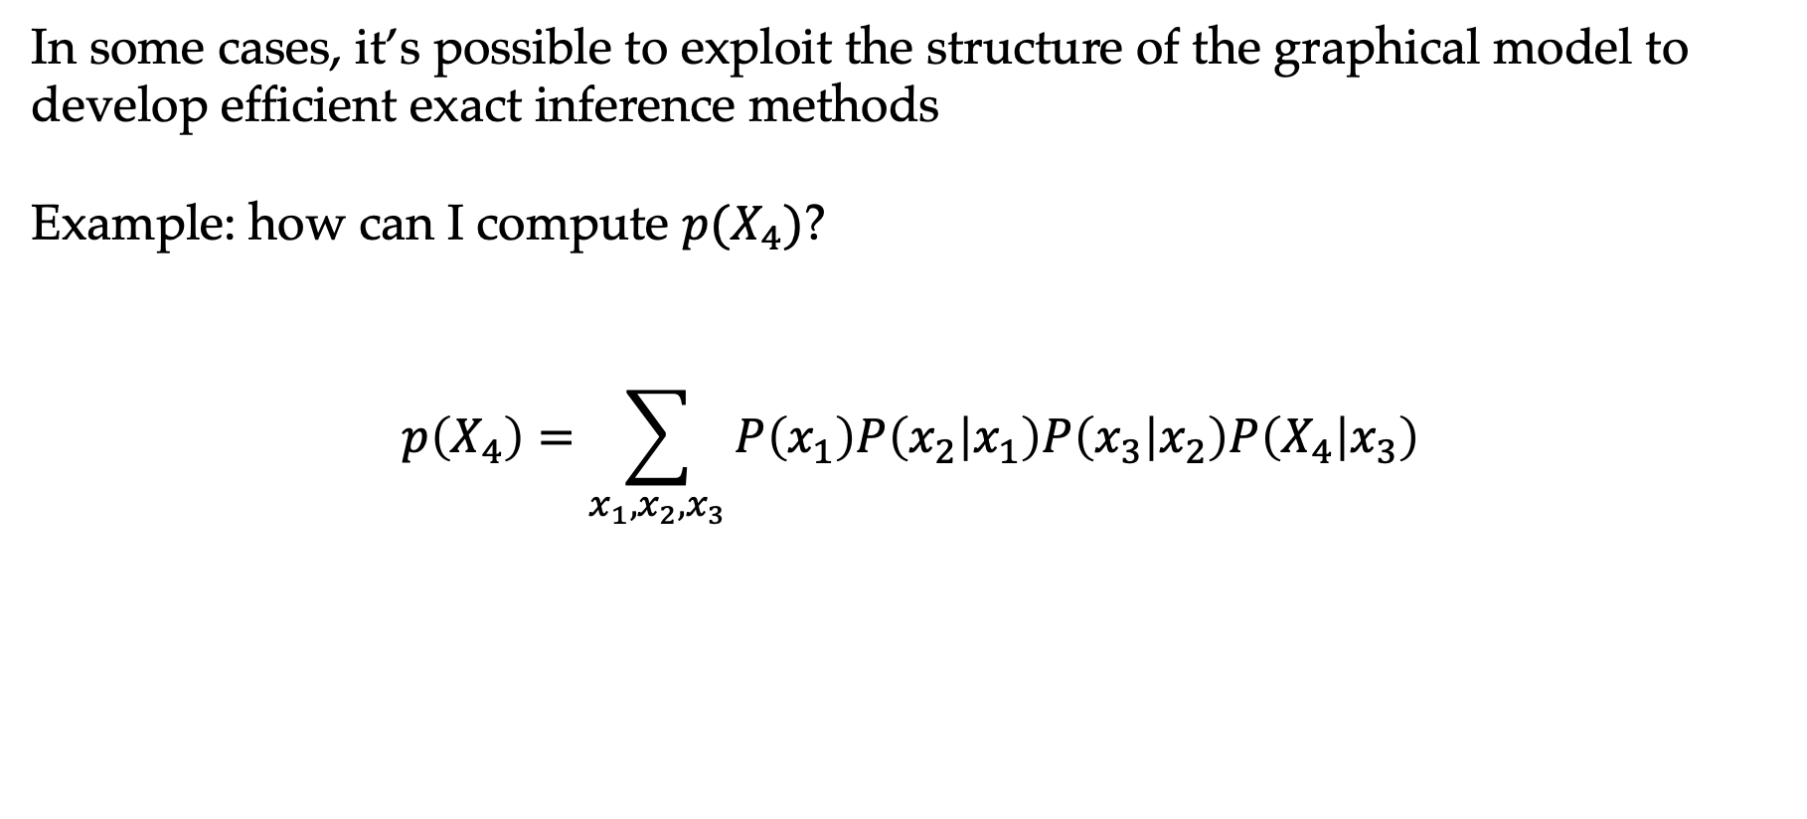
Exact inference in graphical models
In some cases, it’s possible to exploit the structure of the graphical model to develop efficient exact inference methods
Example: how can I compute $p(X_{4})$?
$$p\left(X_{4}\right)=\sum_{x_{1},x_{2},x_{3}}{P\left(x_{1}\right)P\left(x_{2} | x_{1}\right)P\left(x_{3} | x_{2}\right)P\left(X_{4} | x_{3}\right)}$$

Slide 9
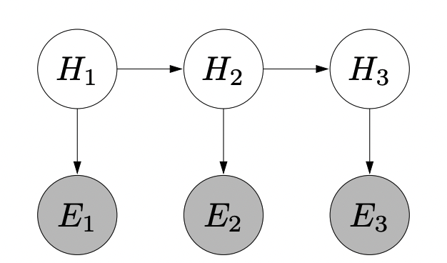
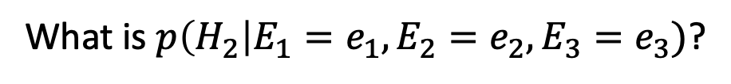
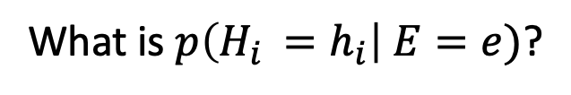
Forward backward algorithm
Hidden Markov Models
What is $p\left(H_{2}\right|E_{1}=e_{1},E_{2}=e_{2},E_{3}=e_{3})$?
What is $p\left(H_{i }=h_{i}\right| E=e)$?

Slide 10
Inference in HMMs
Paths representing assignments to different variables (schematic)
We need to compute probability of each assignment to $h_{1},h_{2},.. h_{n}$ and then normalize

Slide 11
Forward backward algorithm
Forward message
Backward message
Scores

Slide 12
Forward backward algorithm
How does the running time compare to naïve brute force method?

Slide 13
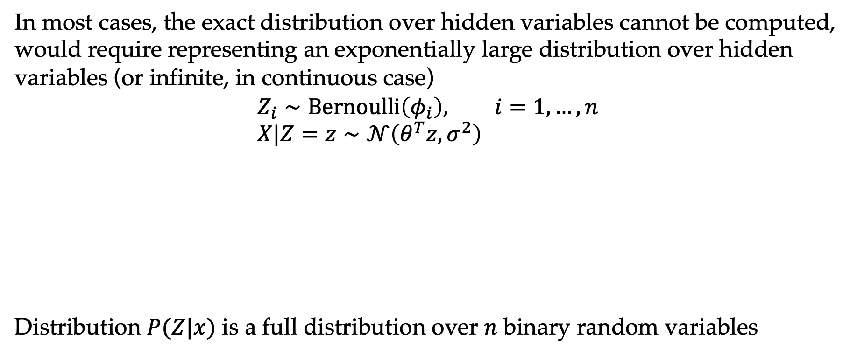
Need for approximate inference
In most cases, the exact distribution over hidden variables cannot be computed, would require representing an exponentially large distribution over hidden variables (or infinite, in continuous case)
$$Z_{i}∼Bernoulli\left(φ_{i}\right), i=1,…,n \\ X|Z=z∼𝒩\left(θ^{T}z, σ^{2}\right)$$
Distribution $P(Z|x)$ is a full distribution over $n$ binary random variables

Slide 14
Outline
Probabilistic graphical models
Probabilistic inference
Exact inference
Sample-based inference
Learning Bayesian networks

Slide 15
Sample-based inference
If we can draw samples from a posterior distribution, then we can approximate arbitrary probabilistic queries about that distribution
A naive strategy (rejection sampling): draw samples from the generative model until we find one that matches the observed data, distribution over other variables will be samples of the hidden variables given observed variables
As we get more complex models, and more observed variables, probability that we see our exact observations goes to zero

Slide 16
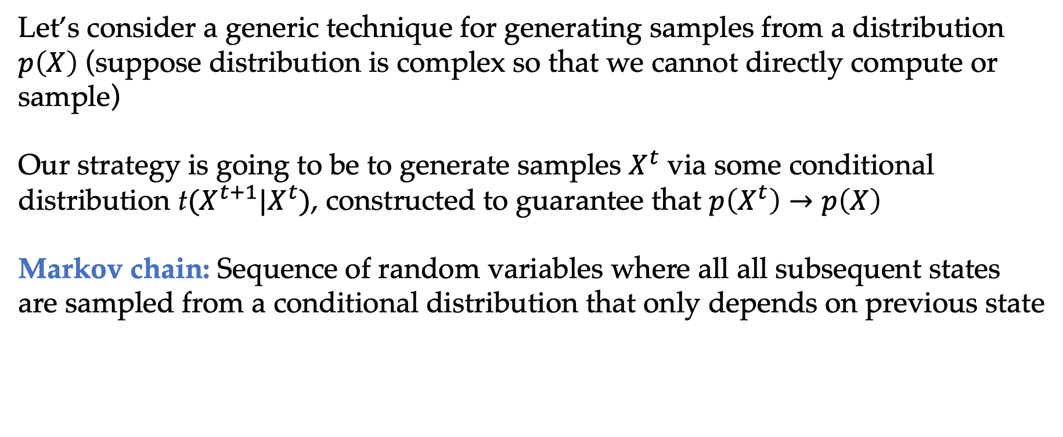
Markov Chain Monte Carlo
Let’s consider a generic technique for generating samples from a distribution $p\left(X\right)$ (suppose distribution is complex so that we cannot directly compute or sample)
Our strategy is going to be to generate samples $X^{t}$ via some conditional distribution t$(X^{t+1}|X^{t})$, constructed to guarantee that $p\left(X^{t}\right)→p\left(X\right)$
Markov chain: Sequence of random variables where all all subsequent states are sampled from a conditional distribution that only depends on previous state

Slide 17
Markov Chain Monte Carlo
High-level idea: Construct a chain whose stationary distribution matches what we want to sample from
Stationary distribution:
Detailed balance:
Under additional assumptions, a distribution satisfying detailed balance is the stationary distribution

Slide 18
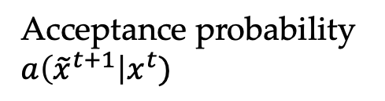
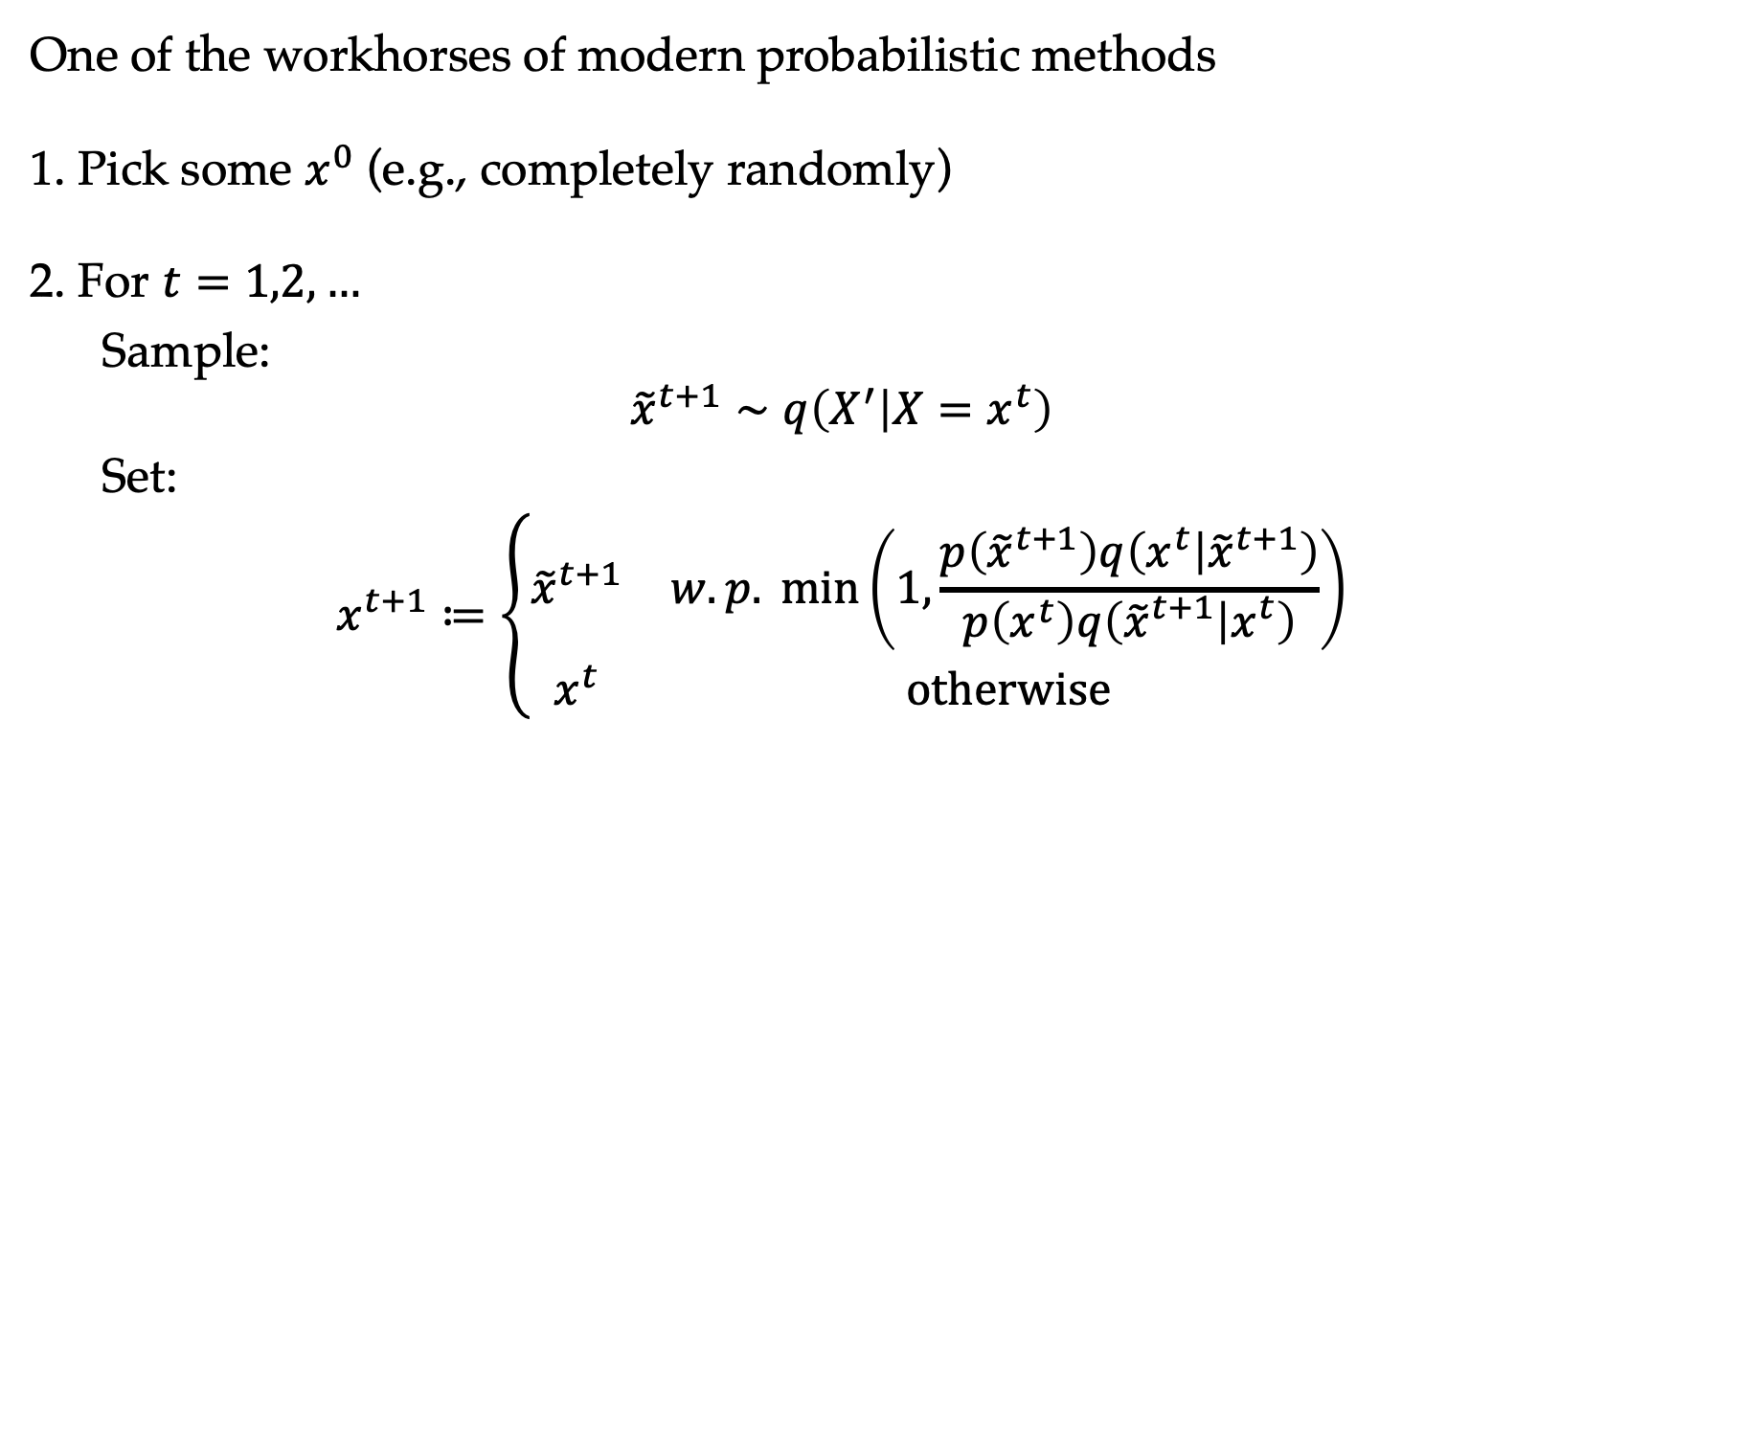
Metropolis-Hastings Algorithm
One of the workhorses of modern probabilistic methods
1. Pick some $x^{0}$ (e.g., completely randomly)
2. For $t=1,2,…$
  Sample:
  $${\tilde{x}}^{t+1}∼q\left(X^{′} | X=x^{t}\right)$$
  Set:
  $$x^{t+1}≔\left\{\begin{matrix}{\tilde{x}}^{t+1} & w.p. \min\left(1,\frac{p\left({\tilde{x}}^{t+1}\right)q\left(x^{t} | {\tilde{x}}^{t+1}\right)}{p\left(x^{t}\right)q\left({\tilde{x}}^{t+1} | x^{t}\right)}\right) \\ x^{t} & otherwise\end{matrix}\right.$$
Proposal distribution
Acceptance probability $a\left({\tilde{x}}^{t+1}\right|x^{t})$

Slide 19
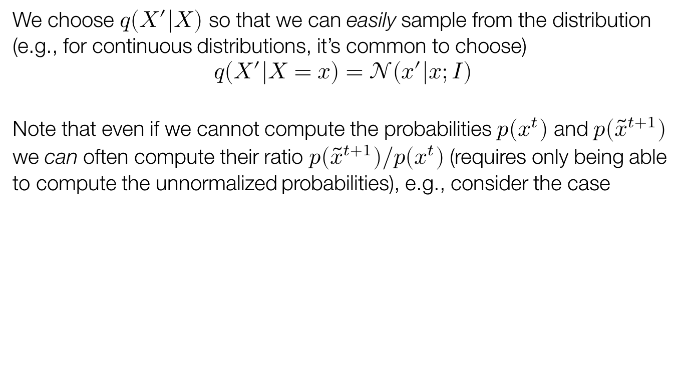
Notes on MH
We choose $q(X^{′}|X)$ so that we can easily sample from the distribution (e.g., for continuous distributions, it’s common to choose)
$$q\left(X^{′} | X=x\right)=𝒩\left(x^{′} | x;I\right)$$
Note that even if we cannot compute the probabilities $p(x^{t})$ and $p({\tilde{x}}^{t+1})$ we can often compute their ratio $p({\tilde{x}}^{t+1})/p(x^{t})$ (requires only being able to compute the unnormalized probabilities), e.g., consider the case

Slide 20
“Proof” of MH algorithm
Want to show that final transition probabilities satisfy detailed balance
Detailed balance => p is the stationary distribution

Slide 21
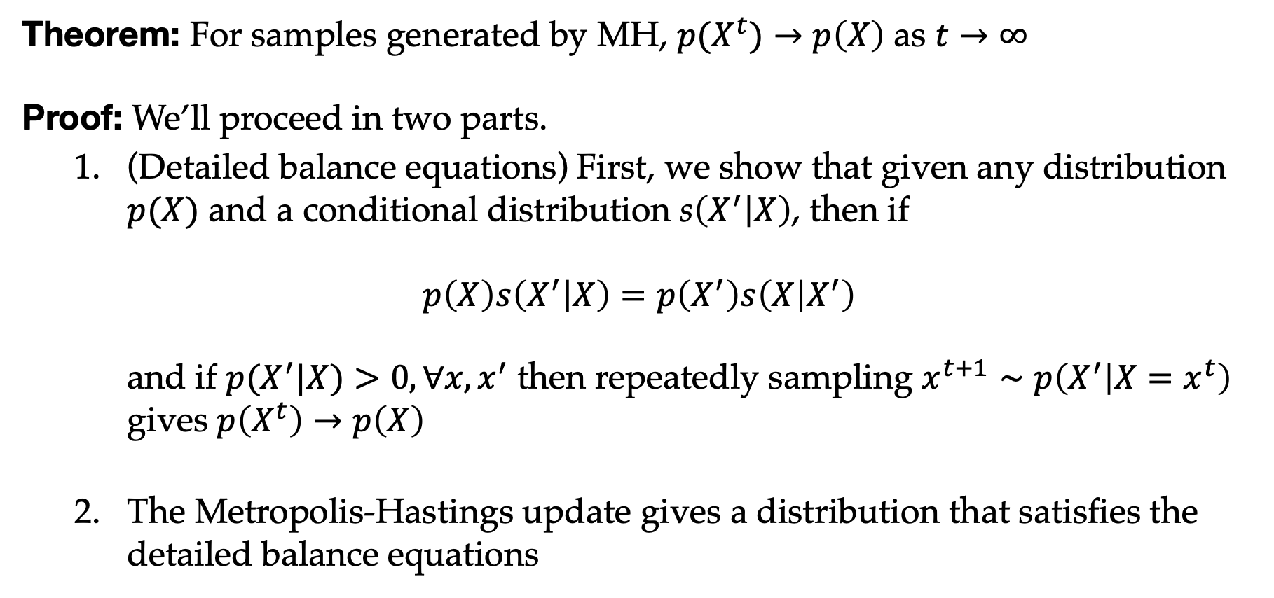
Proof of MH algorithm
Theorem: For samples generated by MH, ${p(X}^{t})→p\left(X\right)$ as $t→∞$
Proof: We’ll proceed in two parts.
  (Detailed balance equations) First, we show that given any distribution $p(X)$ and a conditional distribution s$\left(X^{′} | X\right)$, then if
  $p\left(X\right)s\left(X^{′} | X\right)=p\left(X^{′}\right)s\left(X | X^{′}\right)$
  and if $p(X^{′}|X)>0, ∀x,x^{′}$ then repeatedly sampling $x^{t+1}∼p\left(X^{′} | X=x^{t}\right)$ gives $p\left(X^{t}\right)→p\left(X\right)$
  The Metropolis-Hastings update gives a distribution that satisfies the detailed balance equations

Slide 22
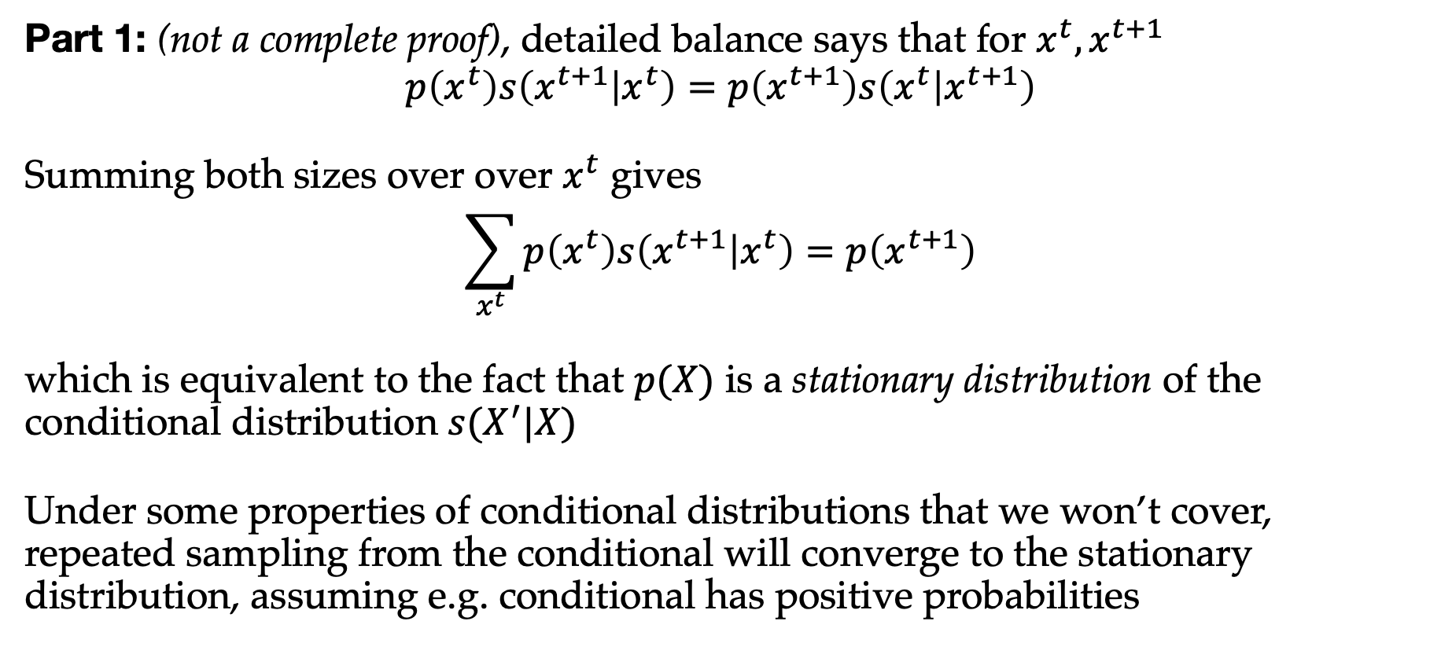
Proof of MH algorithm (cont)
Part 1: (not a complete proof), detailed balance says that for $x^{t}, x^{t+1}$
$$p\left(x^{t}\right)s\left(x^{t+1} | x^{t}\right)=p\left(x^{t+1}\right)s\left(x^{t} | x^{t+1}\right)$$
Summing both sizes over over $x^{t}$ gives
$$\sum_{x^{t}}{p\left(x^{t}\right)s\left(x^{t+1} | x^{t}\right)}=p\left(x^{t+1}\right)$$
which is equivalent to the fact that $p(X)$ is a stationary distribution of the conditional distribution $s(X^{′}|X)$
Under some properties of conditional distributions that we won’t cover, repeated sampling from the conditional will converge to the stationary distribution, assuming e.g. conditional has positive probabilities

Slide 23
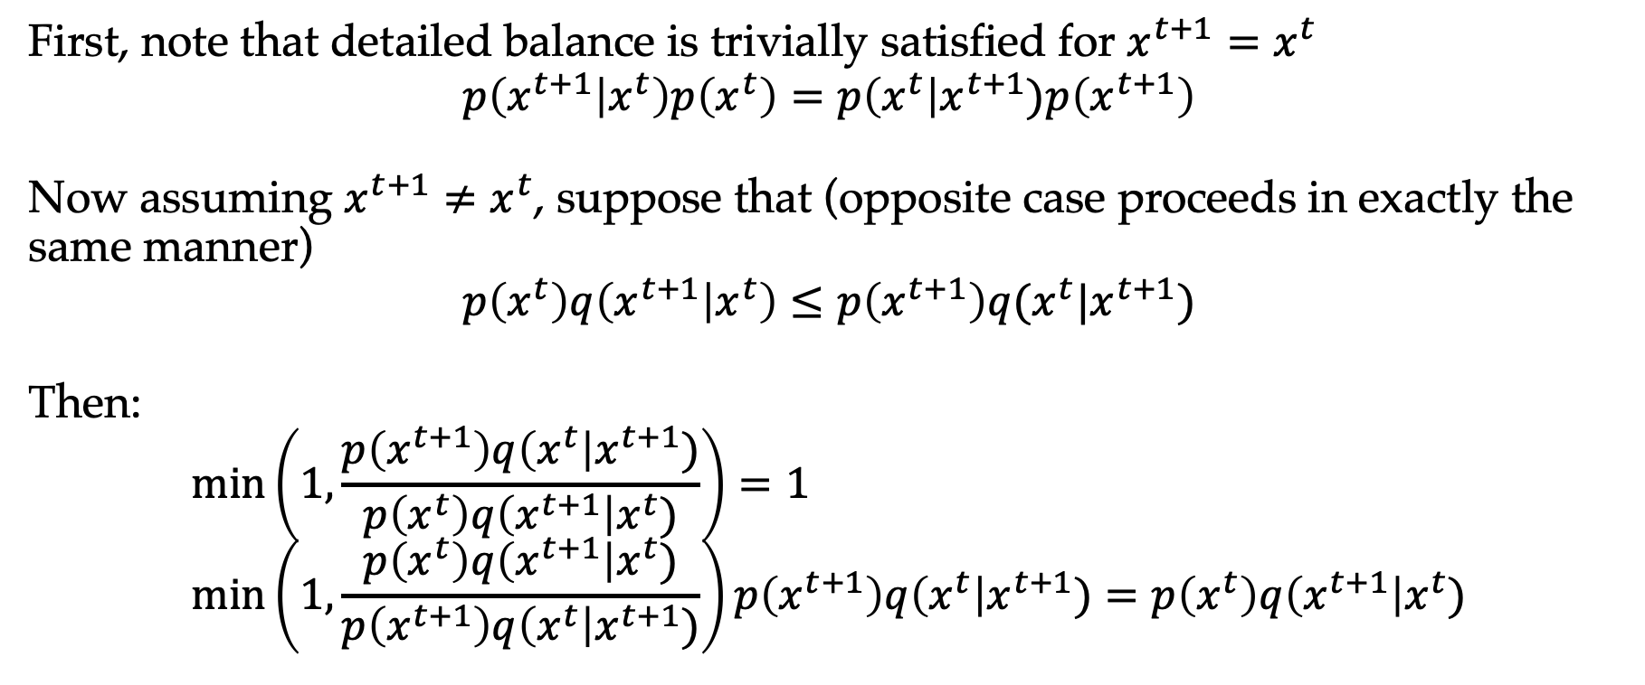
“Proof” of MH algorithm
First, note that detailed balance is trivially satisfied for $x^{t+1}=x^{t}$
$$p\left(x^{t+1} | x^{t}\right)p\left(x^{t}\right)=p\left(x^{t}\right|x^{t+1})p\left(x^{t+1}\right)$$
Now assuming $x^{t+1}≠x^{t}$, suppose that (opposite case proceeds in exactly the same manner)
$$p\left(x^{t}\right)q\left(x^{t+1} | x^{t}\right)≤p\left(x^{t+1}\right)q(x^{t}|x^{t+1})$$
Then:
$$\min\left(1,\frac{p\left(x^{t+1}\right)q\left(x^{t}\right|x^{t+1})}{p\left(x^{t}\right)q\left(x^{t+1}\right|x^{t})}\right)=1 \\ \min\left(1,\frac{p\left(x^{t}\right)q\left(x^{t+1}\right|x^{t})}{p\left(x^{t+1}\right)q\left(x^{t}\right|x^{t+1})}\right)p\left(x^{t+1}\right)q\left(x^{t}\right|x^{t+1})=p\left(x^{t}\right)q\left(x^{t+1}\right|x^{t})$$

Slide 24
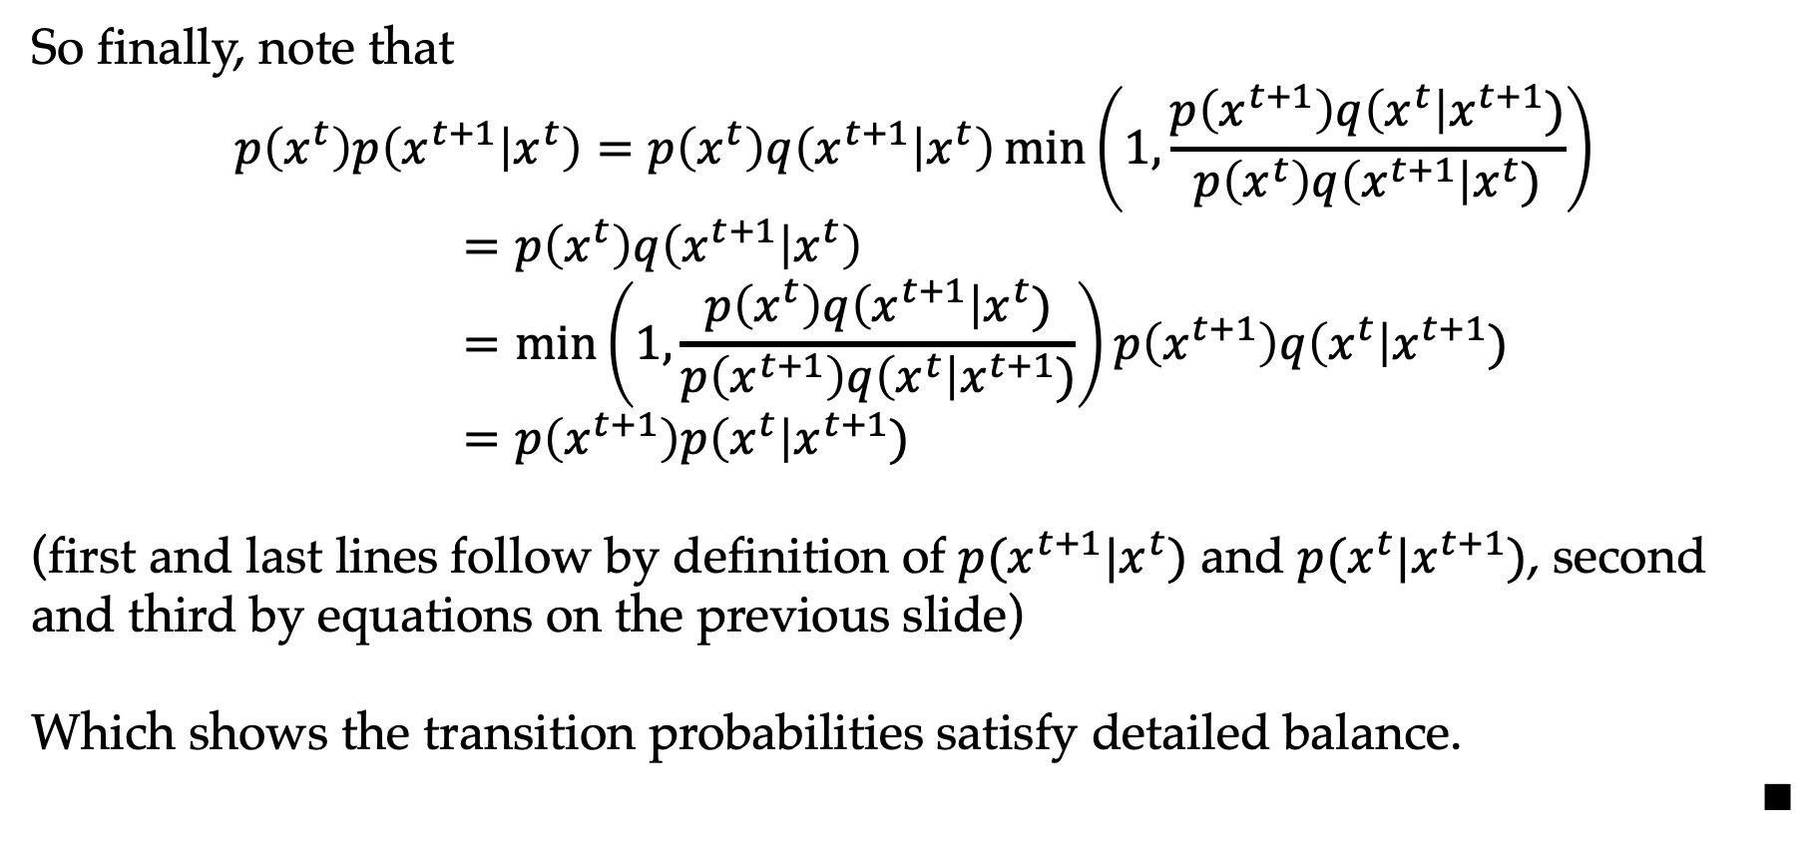
Proof of MH algorithm (cont)
So finally, note that
$$p\left(x^{t}\right)p\left(x^{t+1} | x^{t}\right)=p\left(x^{t}\right)q\left(x^{t+1} | x^{t}\right)\min\left(1,\frac{p\left(x^{t+1}\right)q\left(x^{t}\right|x^{t+1})}{p\left(x^{t}\right)q\left(x^{t+1}\right|x^{t})}\right) \\ =p\left(x^{t}\right)q\left(x^{t+1} | x^{t}\right) \\ =\min\left(1,\frac{p\left(x^{t}\right)q\left(x^{t+1}\right|x^{t})}{p\left(x^{t+1}\right)q\left(x^{t}\right|x^{t+1})}\right)p\left(x^{t+1}\right)q\left(x^{t}\right|x^{t+1}) \\ =p\left(x^{t+1}\right)p\left(x^{t}\right|x^{t+1})$$
(first and last lines follow by definition of $p(x^{t+1}|x^{t})$ and $p(x^{t}|x^{t+1})$, second and third by equations on the previous slide)
Which shows the transition probabilities satisfy detailed balance.
$$∎$$

Slide 25
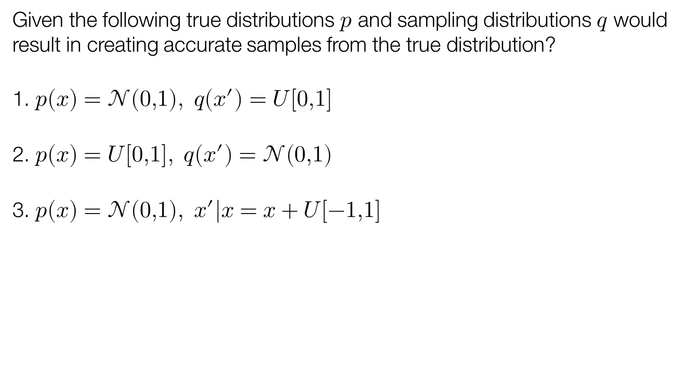
Poll: Metropolis-Hastings
Given the following true distributions $p$ and sampling distributions $q$ would result in creating accurate samples from the true distribution?
1. $p\left(x\right)=𝒩\left(0,1\right), q\left(x^{′}\right)=U\left[0,1\right]$
2. $p\left(x\right)=U\left[0,1\right], q\left(x^{′}\right)=𝒩(0,1)$
3. $p\left(x\right)=𝒩\left(0,1\right), x^{′}|x=x+U\left[−1,1\right]$

Slide 26
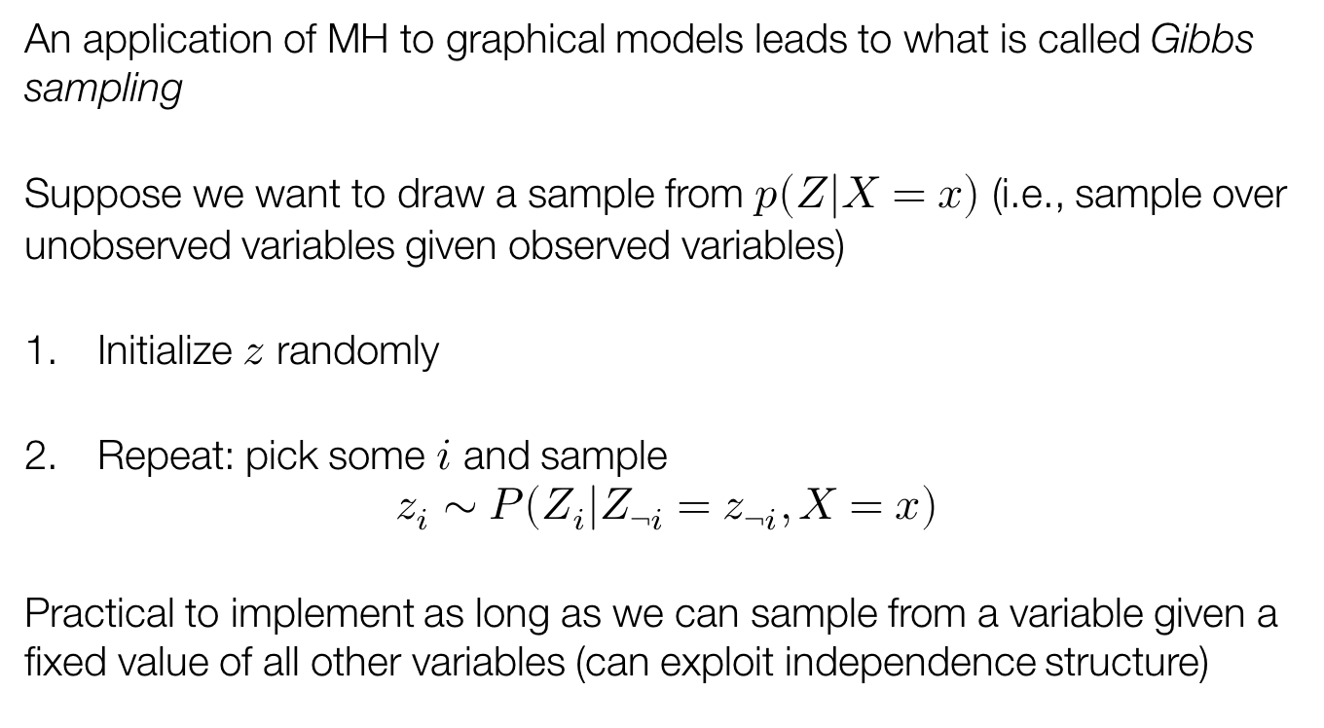
Gibbs sampling
An application of MH to graphical models leads to what is called Gibbs sampling
Suppose we want to draw a sample from $p(Z|X=x)$ (i.e., sample over unobserved variables given observed variables)
Initialize $z$ randomly
Repeat: pick some $i$ and sample
$z_{i}∼P(Z_{i}|Z_{¬i}=z_{¬i}, X=x)$
Practical to implement as long as we can sample from a variable given a fixed value of all other variables (can exploit independence structure)

Slide 27
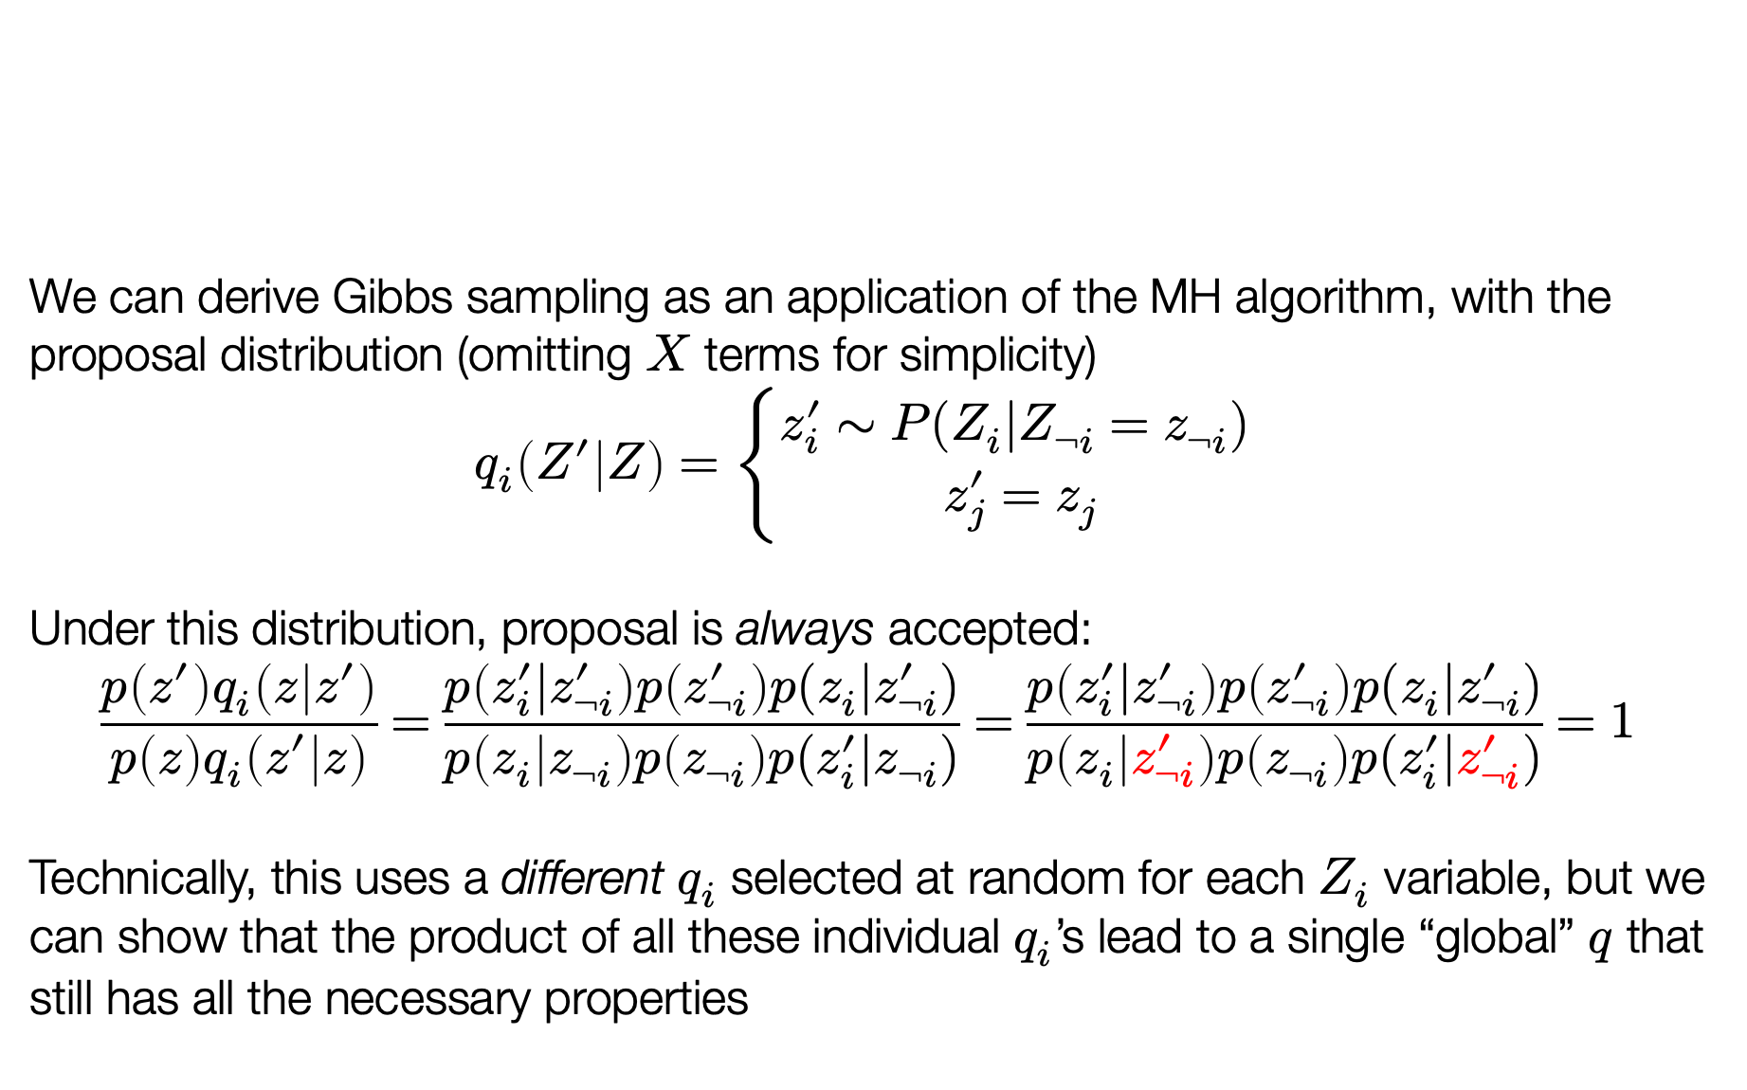
Gibbs as Metropolis-Hastings
We can derive Gibbs sampling as an application of the MH algorithm, with the proposal distribution (omitting $X$ terms for simplicity)
$$q_{i}\left(Z^{′} | Z\right)=\left\{\begin{aligned}z_{i}^{′}∼P(Z_{i}|Z_{¬i}=z_{¬i}) \\ z_{j}^{′}=z_{j}\end{aligned}\right.$$
Under this distribution, proposal is always accepted:
$$\frac{p\left(z^{′}\right)q_{i}\left(z | z^{′}\right)}{p\left(z\right)q_{i}\left(z^{′} | z\right)}=\frac{p\left(z_{i}^{′}|z_{¬i}^{′}\right)p\left(z_{¬i}^{′}\right)p(z_{i}|z_{¬i}^{′})}{p\left(z_{i} | z_{¬i}\right)p\left(z_{¬i}\right)p(z_{i}^{′}|z_{¬i})}=\frac{p\left(z_{i}^{′}|z_{¬i}^{′}\right)p\left(z_{¬i}^{′}\right)p(z_{i}|z_{¬i}^{′})}{p\left(z_{i} | z_{¬i}^{′}\right)p\left(z_{¬i}\right)p(z_{i}^{′}|z_{¬i}^{′})}=1$$
Technically, this uses a different $q_{i}$ selected at random for each $Z_{i}$ variable, but we can show that the product of all these individual $q_{i}$’s lead to a single “global” $q$ that still has all the necessary properties

Slide 28
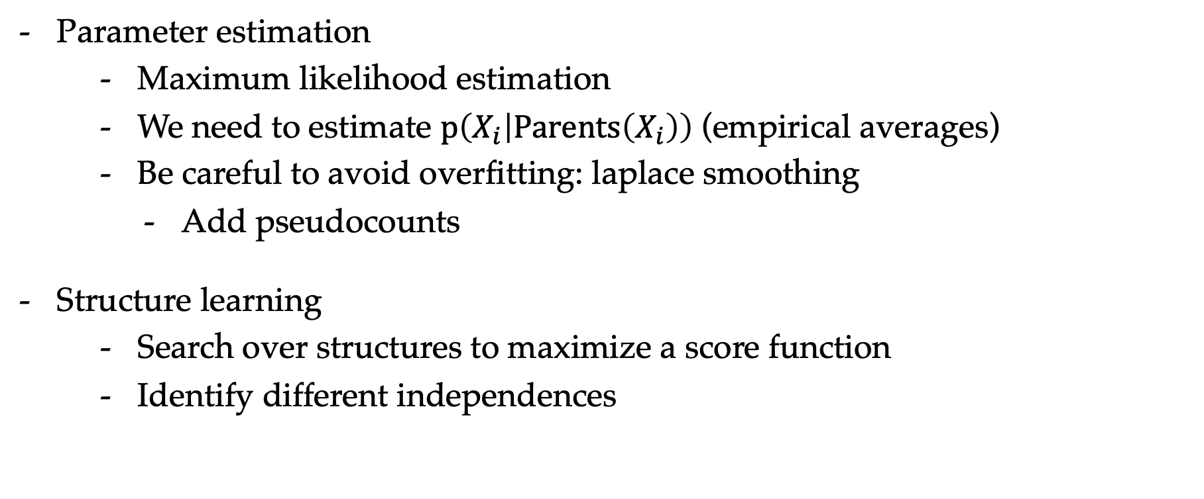
Learning Bayesian networks
Parameter estimation
  Maximum likelihood estimation
  We need to estimate $p\left(X_{i} | Parents\left(X_{i}\right)\right)$ (empirical averages)
  Be careful to avoid overfitting: laplace smoothing
    Add pseudocounts
Structure learning
  Search over structures to maximize a score function
  Identify different independences

Slide 29
Outline
Probabilistic graphical models
Probabilistic inference
Exact inference
Sample-based inference
A brief look at deep generative models

Slide 30
Deep generative models
Probabilistic models + deep learning (what could be better?)
A huge landscape, going back many years, and we will just briefly highlight two common current approaches
  Variational autoencoders
  Generative adversarial networks
  See also (not discussed): normalizing flow models, diffusion models

Slide 31
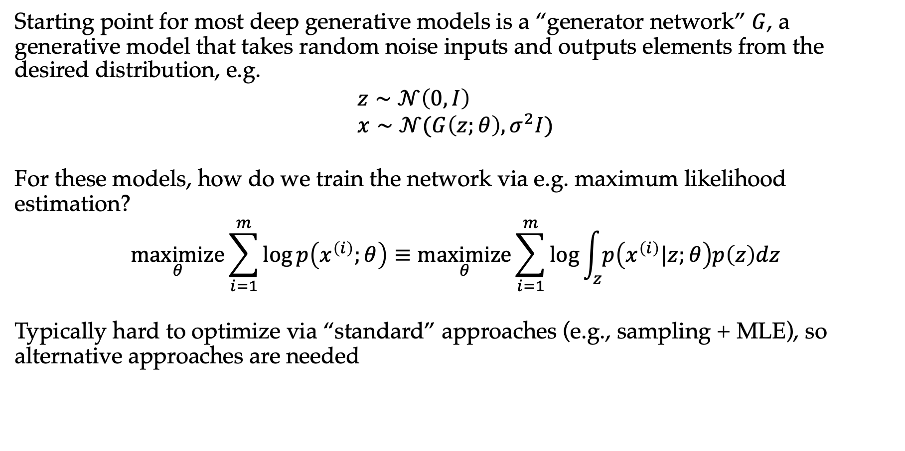
Generator networks
Starting point for most deep generative models is a “generator network” $G$, a generative model that takes random noise inputs and outputs elements from the desired distribution, e.g.
$$z∼𝒩\left(0,I\right) \\ x∼𝒩(G\left(z;θ\right),σ^{2}I)$$
For these models, how do we train the network via e.g. maximum likelihood estimation?
$$\underset{θ}{maximize}{\sum_{i=1}^{m}{\log{p\left(x^{\left(i\right)};θ\right)}}≡\underset{θ}{maximize}{\sum_{i=1}^{m}{\log{\int_{z}{p\left(x^{\left(i\right)}|z;θ\right)p\left(z\right)dz}}}}}$$
Typically hard to optimize via “standard” approaches (e.g., sampling + MLE), so alternative approaches are needed

Slide 32
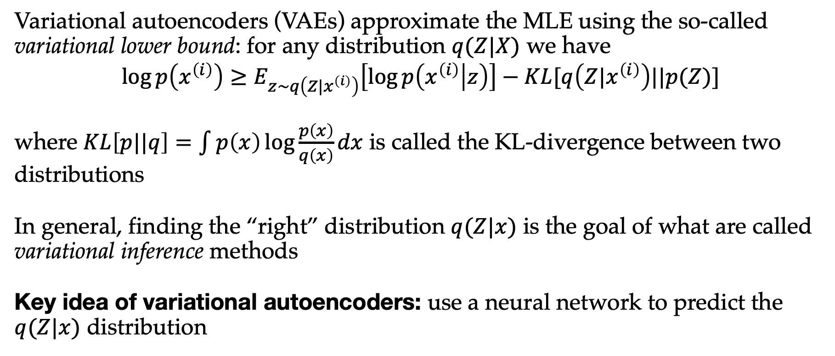
Variational autoencoders
Variational autoencoders (VAEs) approximate the MLE using the so-called variational lower bound: for any distribution $q(Z|X)$ we have
$$\log{p\left(x^{\left(i\right)}\right)}≥E_{z∼q\left(Z|x^{\left(i\right)}\right)}\left[\log{p\left(x^{\left(i\right)} | z\right)}\right]−KL[q\left(Z|x^{\left(i\right)}\right)||p(Z)]$$
where $KL\left[p||q\right]=\int{p\left(x\right)⁡\log{\frac{p\left(x\right)}{q\left(x\right)}}}dx$ is called the KL-divergence between two distributions
In general, finding the “right” distribution $q(Z|x)$ is the goal of what are called variational inference methods
Key idea of variational autoencoders: use a neural network to predict the $q(Z|x)$ distribution

Slide 33
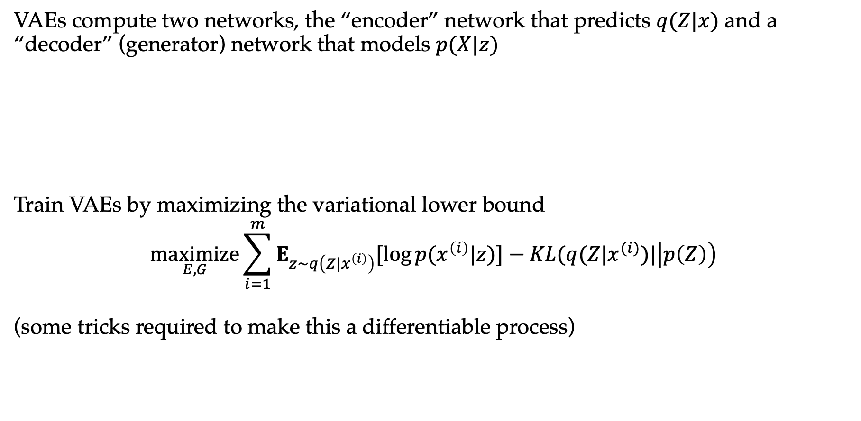
VAEs continued
VAEs compute two networks, the “encoder” network that predicts $q(Z|x)$ and a “decoder” (generator) network that models $p(X|z)$
Train VAEs by maximizing the variational lower bound
$$\underset{E,G}{maximize}{\sum_{i=1}^{m}{E_{z∼q\left(Z|x^{\left(i\right)}\right)}[\log{p(x^{\left(i\right)}|z)]}}−KL(q(Z|x^{(i)})|\left|p\left(Z\right)\right)}$$
(some tricks required to make this a differentiable process)

Slide 34
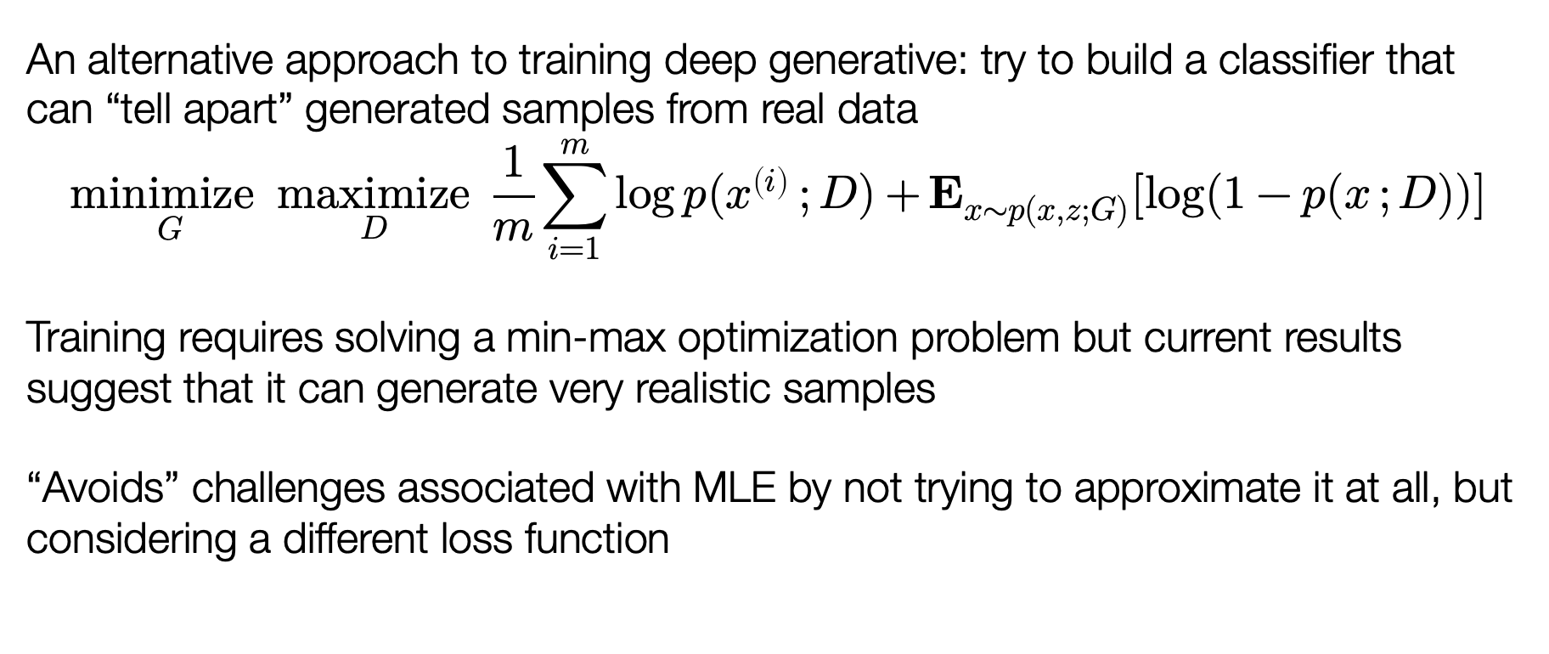
Generative adversarial models (GANs)
An alternative approach to training deep generative: try to build a classifier that can “tell apart” generated samples from real data
$$\underset{G}{minimize}{\underset{D}{maximize}{\frac{1}{m}\sum_{i=1}^{m}{\log{p(x^{\left(i\right)}};D)+}E_{x∼p(x,z;G)}[\log{(1−p(x};D))]}}$$
Training requires solving a min-max optimization problem but current results suggest that it can generate very realistic samples
“Avoids” challenges associated with MLE by not trying to approximate it at all, but considering a different loss function

Slide 35
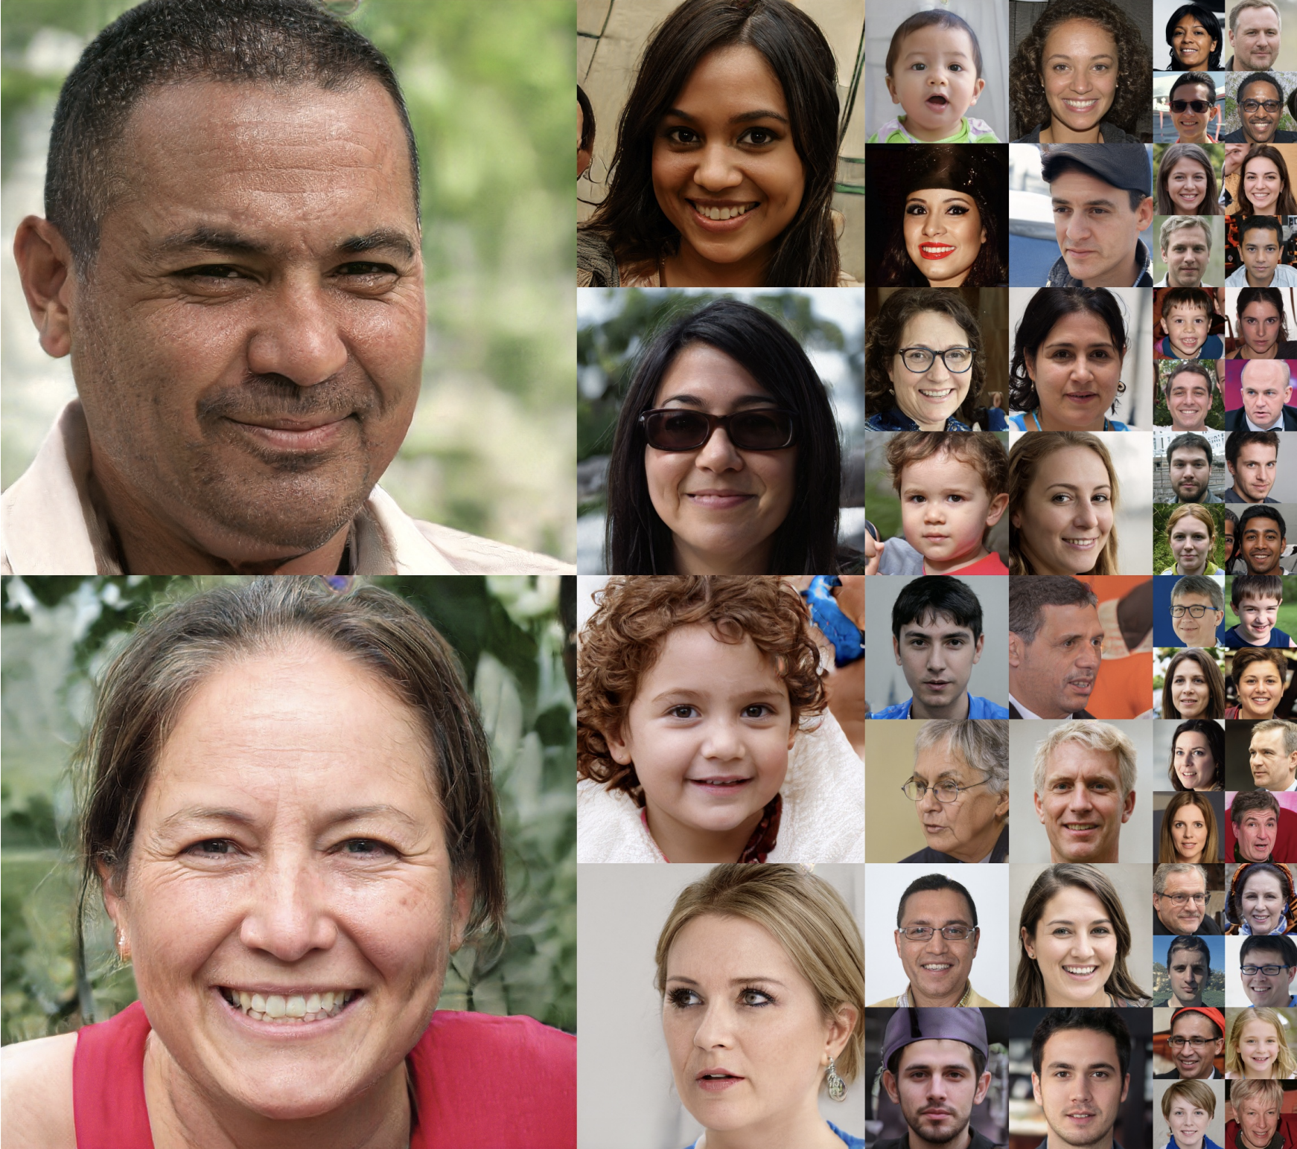
Examples of GANs
Samples of faces generated by (quite complex) GAN
Figure from
(Kerras et al., 2018)

